Slide 1
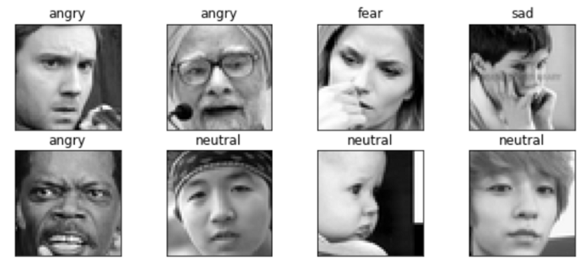
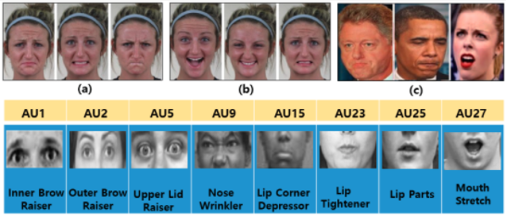
Facial Emotion Recognition
Facial emotion recognition is the process of detecting human emotions from facial expressions. Real time facial emotion recognition systems are nowadays used in a variety of ways, such as driver monitoring systems for driver and occupant state in the car (fatigue, distraction, etc.) In this project we would like to use AI solutions to reconstruct this technology and then review the results and discuss on ways to improve them in future projects.

